Slide 1
CRIME DATA DASHBOARD
SOUTH EASTERN COALFIELD LIMITED (Korba)
NAME - KARISHMA RATHORE
UNIVERSITY ROLL NO- 301402222203

Slide 2
CONTENT
INTRODUCTION
OBJECTIVES
TECHNOLOGY STACK AND DATASETS
SYSTEM ARCHITECTURE AND PREPROCESSING
ML MODEL AND DASHBOARD FEATURES
TREND , PREDICTION , AND HOTSPOT EXAMPLE
RESULT
FUTURE SCOPE
CONCLUSION

Slide 3
INTRODUCTION
• Crime is a major challenge for urban safety.
• Data-driven approaches can help analyze patterns & predict crime trends.
• This project builds an AI-powered dashboard for analysis & prediction.

Slide 4
OBJECTIVES
• Build a dashboard to analyze crime data.
• Enable interactive visualizations (charts, maps, filters).
• Apply Machine Learning to predict future crime trends.
• Support decision-making with data insights

Slide 5
TECHNOLOGY STACK
• Python (data handling + ML)
• Libraries: Pandas, NumPy, Scikit-learn, Plotly, Streamlit
• Dashboard: Streamlit
• ML Model: Linear Regression

Slide 6
DATASET
• Source: Open crime datasets (e.g., Kaggle, Chicago Crime Data).
• Attributes:
- Date, Year
- Crime Type
- Location (City, Lat, Long)
• Example: 2022-02-22, Burglary, New York, 40.7128, -74.0060

Slide 7
SYSTEM ARCHITECTURE
Input: Crime dataset (CSV)
Processing: Preprocessing & ML training
Dashboard: Interactive filters & charts
Output: Visualizations + Predictions

Slide 8
DATA PREPROCESSING
• Handle missing values.
• Extract year from date.
• Encode crime types.
• Group data for trend analysis.

Slide 9
MACHINE LEARNING MODEL
• Model: Linear Regression
• Input: Year
• Output: Predicted number of crimes
• Trained on historical data
]][• Predicts for future years (e.g., 2024–2026)

Slide 10
DASHBOARD FEATURES
• Dataset preview table
• Trend line chart (actual + predicted)
• Crime type distribution (pie chart)
• Hotspot map (crime locations)
• Sidebar filters (crime type, year range)

Slide 11
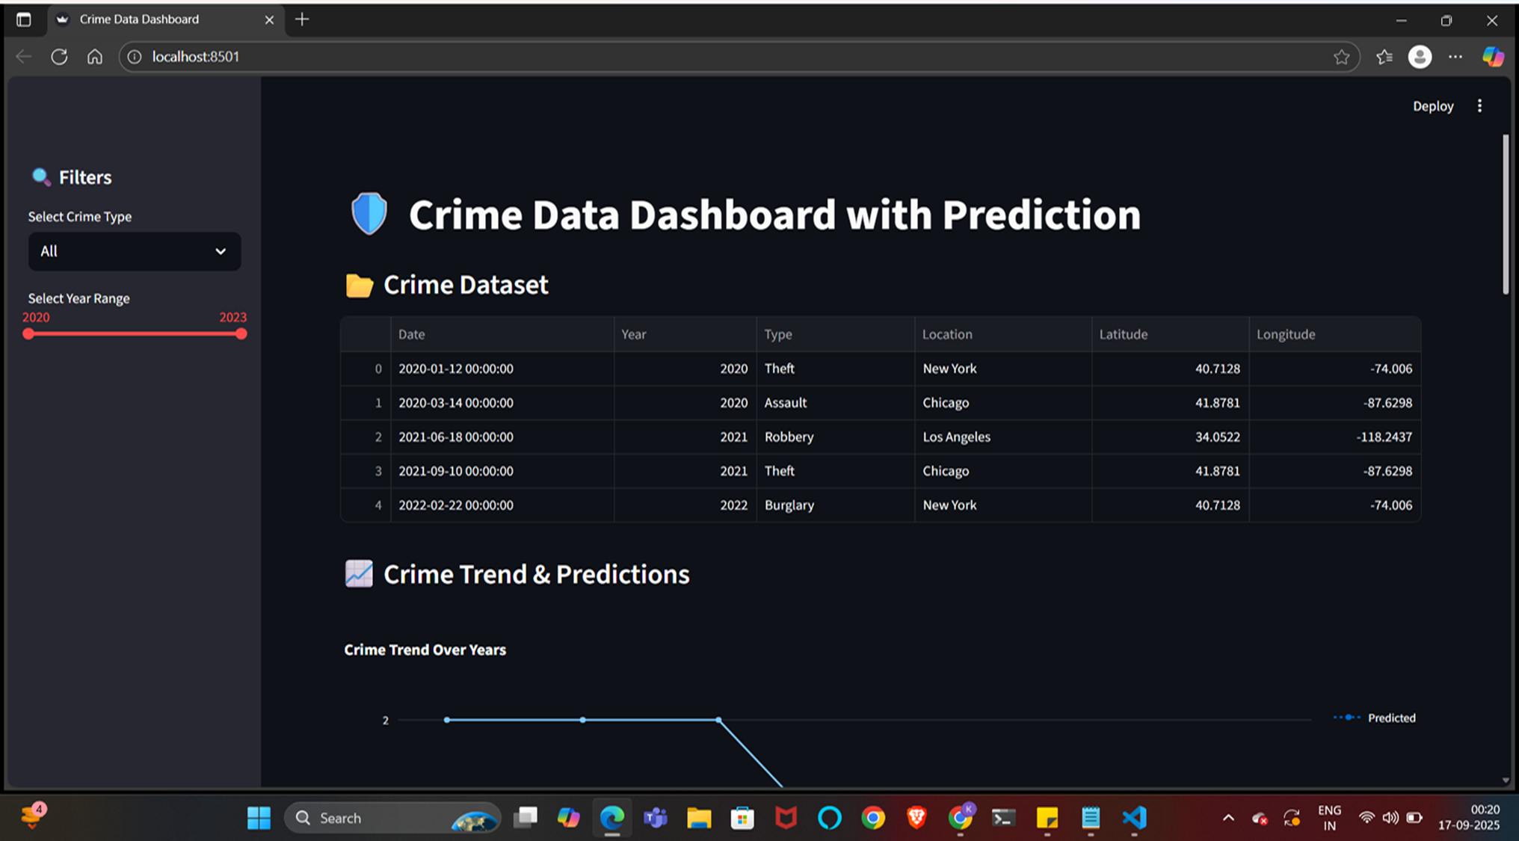
TREND ANALYSIS
• Shows crime increase/decrease over years.
• Helps understand long-term trends.

Slide 12
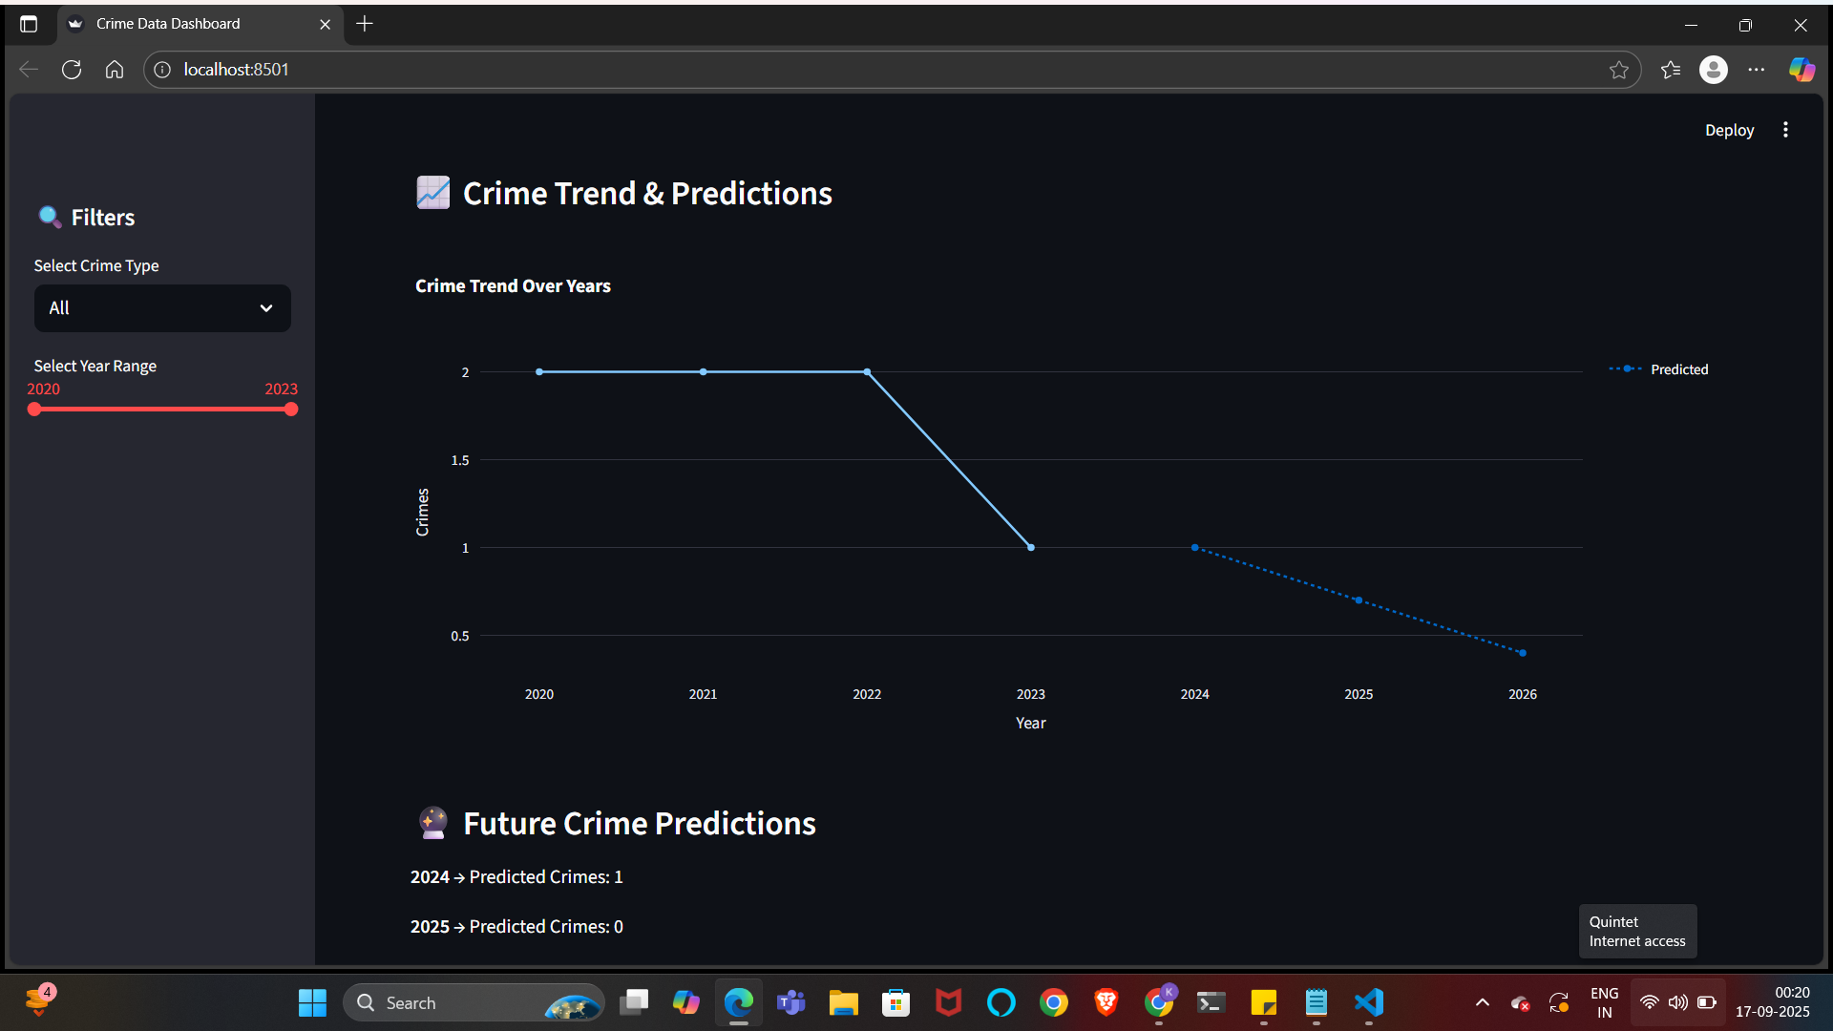

Slide 13
PREDICTION
• Predicted future crimes (2024–2026).
• Useful for law enforcement resource planning.

Slide 14
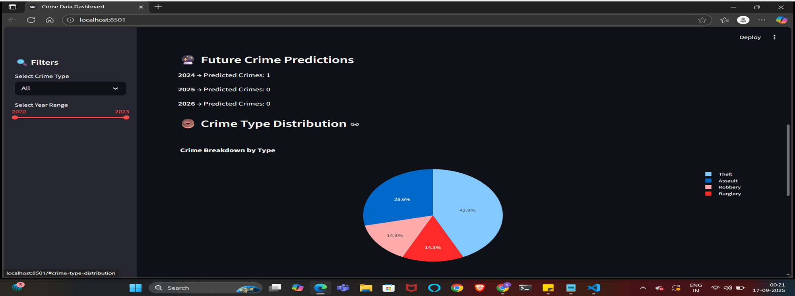

Slide 15
HOTSPOT MAP
• Crime plotted on OpenStreetMap.
• Different colors for each crime type.
• Helps identify high-risk areas

Slide 16
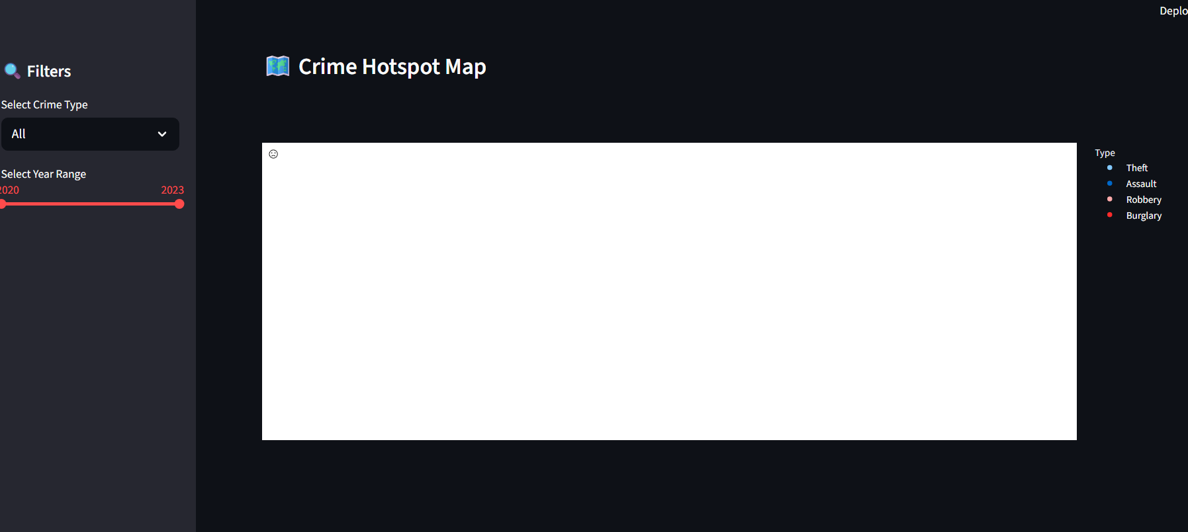

Slide 17
RESULTS
• Crime trends clearly visualized.
• Predictions provide insight into future risks.
• Dashboard is easy to use & interactive.
• Can be extended with advanced models.

Slide 18
FUTURE SCOPE
• Integrate ARIMA/Prophet for time series forecasting.
• Add real-time data streaming from police databases.
• Deploy on web (Heroku/AWS) for public use.
• Extend to include cybercrime & fraud detection.

Slide 19
CONCLUSION
• Successfully built a Crime Data Dashboard with Prediction.
• Combines Python, AI/ML & Visualization.
• Provides valuable insights for crime analysis & planning.
• Excellent application of training knowledge in real-world problem

Slide 20
THANKYOU

